Slide 1
10 DAYS / 09 NIGHTS EXPLORE PAPUA
KOROWAY TREE HOUSE TRIBE

Slide 2
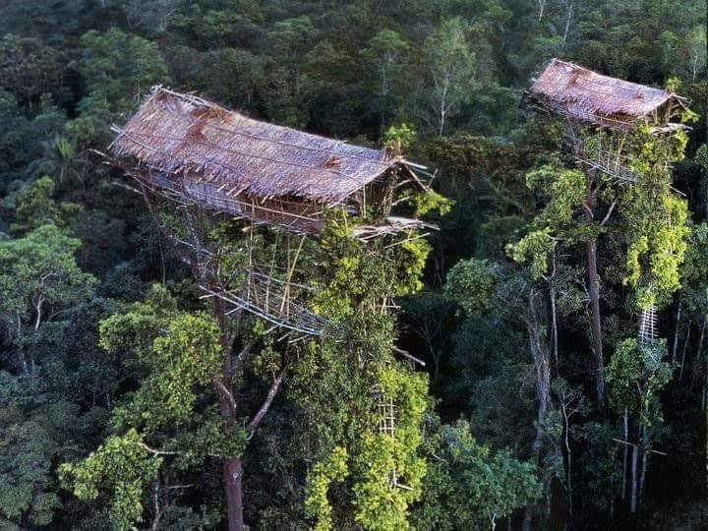
TOUR ITINERARIES
Day 01. Arrive Jayapura, lake tour and city tour.Stayat hotel, ( LD ).
Day 02. Fly to Dekai. Overnight at hotel.( BLD ).
Day 03. Dekai – log pon – sipanap/ mabul.by boat/engine boat. Overnight at local house or tent.(BLD )
Day 04. Sipanap/Mabul- trekking in to deep forest at least 4 hours to meet The Korowat Tree house tribe. ( BLD)
Day 05 – 07. Stay with Koroway tribe.See their daily life and mingle with them to do the Sago pounding, take Sago worms and goingwith koroway men for traditional wild animals hunting.( BLD ).
Day 08. Drive by boat return to Dekai .Stay at hotel. ( BLD ).

Slide 3
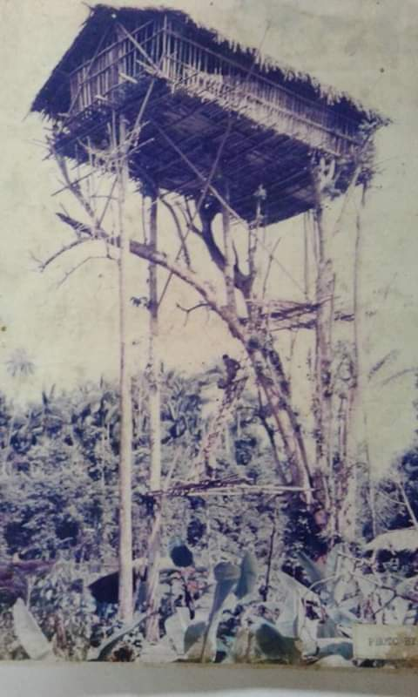
Day 09. Fly return to Jayapura. Sightseeing tour. Stay at hotel. ( BLD).
Day 10. Transfer you to the airport for your departure to the next destination.
ENDS OF PROGRAM.
TOUR PRICE :
01 – 06 persons. Rp. 40.000.000,./pax
07 - 12 persons. Rp. 35.000.000,./pax
13 – Up persons. Rp. 30.000.000.,./pax
TOUR PRICES INCLUDINGS:
Internal Air ticket in Papua area, police permit, allcar transports and all accomodation, full boards meals, guide fee,porters fee, donationbs, entrances fee,,

Slide 4
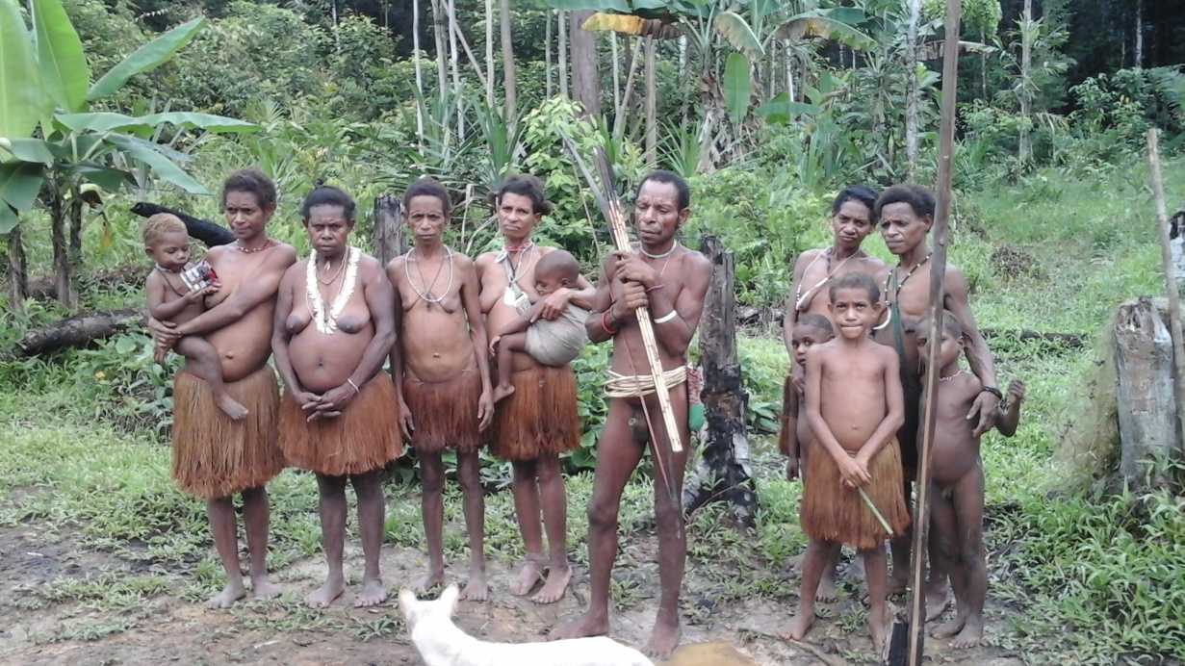
TOUR PRICES EXCLUDED :
Personal Expenses,softdrink,beverages,laundry,Tipping.
PRICEVALID UNTIL 31 DECEMBER 2023.
Itinerary and price are subject to change. With or without prior notice.
Force majeuror uncontrolled :Loss, damage, or natural disaster that may effect the tour beyondour control.
PAYMENT :
Fullpayment must be made at least 30 days before the date of travel.
Down paymentisnon- refundable.

Slide 5
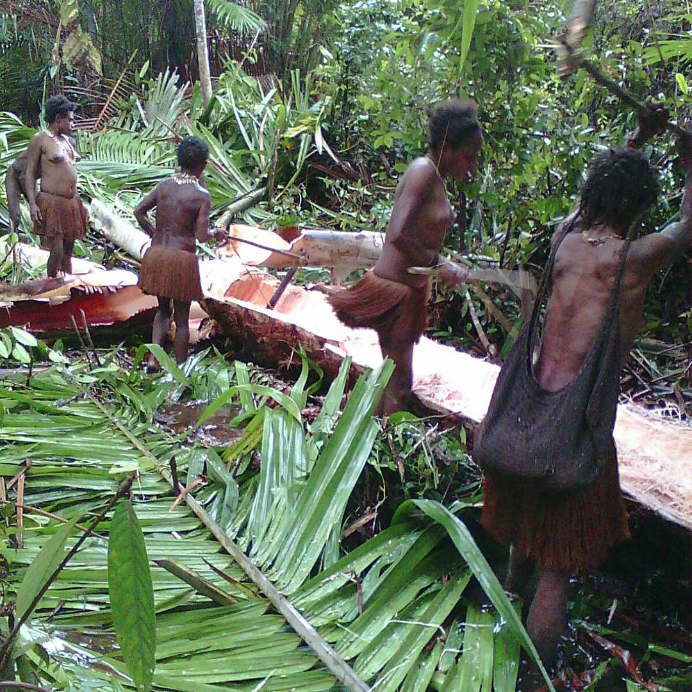
CANCELLATION :
On the spesified date in the ivent ofa change/cacellation/transfer date/travel transfer, a fee will be charged prior bto the departure date.
CONTACT PERSON :
SIMSON NICKY MEHUE,
Phone / Whatsapp : +62 81354075568
Email : mehuenicky@gmail.com
: nickymehue@gmail.com

