Slide 1
07 DAYS / 06 NIGHTS ASMAT TRIBE EXPLORE
THE FAMOUS OF THE WOODEN CARVING TRIBE

Slide 2

TOUR PROGRAMS.
Day 01 : Timika – Ewer – Agatz / Asmat. Stay hotel. ( BLD ).
Day 02 : Explore Asmat villages by boat. Stay at local house or Tent.
Day 03 : Continue to explore Asmat Villages. Stayat local house or tent. ( BLD ).
Day 04 :Traditional Asmat tribe ceremony of the Ancesstors Poles Statues. Stay at hotel in Agatz. ( BLD ).
Day 05 : Sightseeing Agatz Town vist famous Asmat Museum.Stay at hotel.( BLD ).
Day 06 :Fly toTimika, visit Kuala Kencana.Stay at hotel. ( BLD ).
Day 07 :Departure out from Timika to your next destination.
Ends of Services.

Slide 3
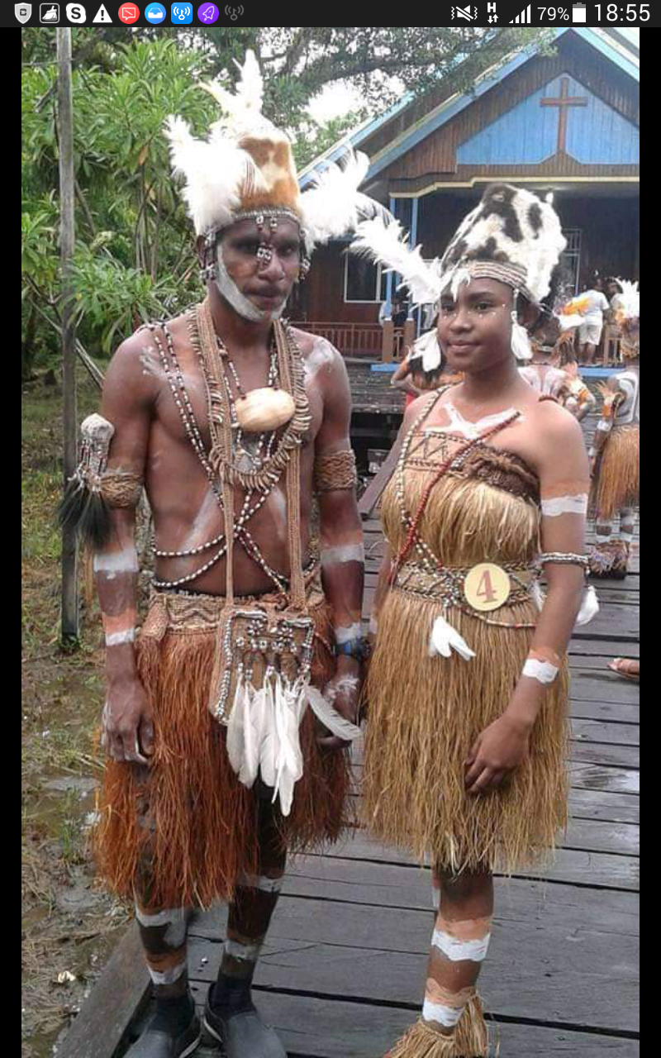
TOUR PRICES :
01 – 06 persons...Rp. 35.000.000,./pax.
07 – 12 persons...Rp. 30.000.000,./pax.
13 – Up persons..Rp.25.000.000,./pax.
TOUR PRICE INCLUDINGS :
Air ticket Timika – Ewer – Timika, Police Permit,Boat canoe inAsmat, all accomodations, all transports, guide fee,porters fee, traditionals ceremony performances,
Full boards meals, donations and entrances fee.
TOUR PRICES EXCLUDED :
Personal Expenses, soft drink, beverages, laundry, personal needs and others case beyond of guide controll,tipping.

Slide 4
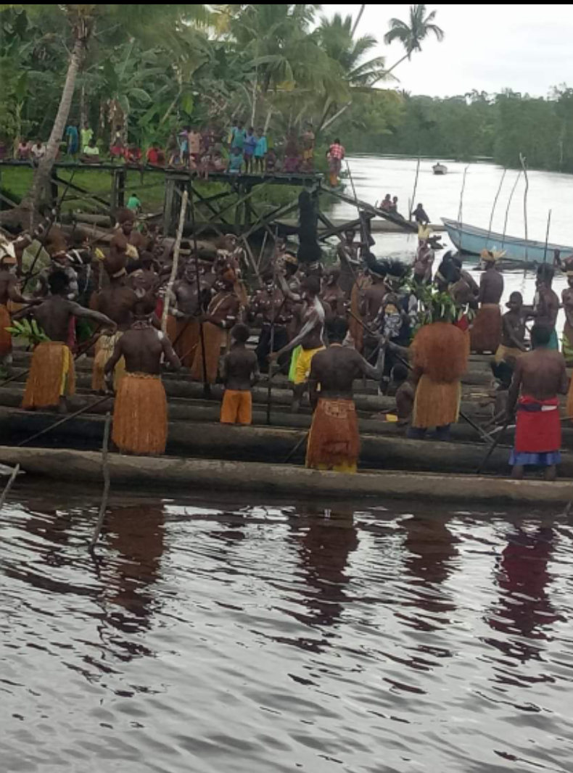
PRICE VALID UNTIL 31DECEMBER 2023
Itinerary and price are subject to change with or without prior notice.
Force majeur or uncontrolled : Loss, demage, or natural disasters that may effect the tour beyond of our controll..
PAYMENT :
Full payment must be at least 30 days before the date of travel.
Down payment is non – refundable.
CANCELLATION :
On the spesified datein the ivent of a change/ cancellation/transfer date/travel transfer, a fee willbe charged prior to departure date.
CONTACT PERSON:
SIMSON NICKY MEHUE
Phone/Whatsapp:+62 81354075568
Email : nickymehue@gmail.com

